Slide 1
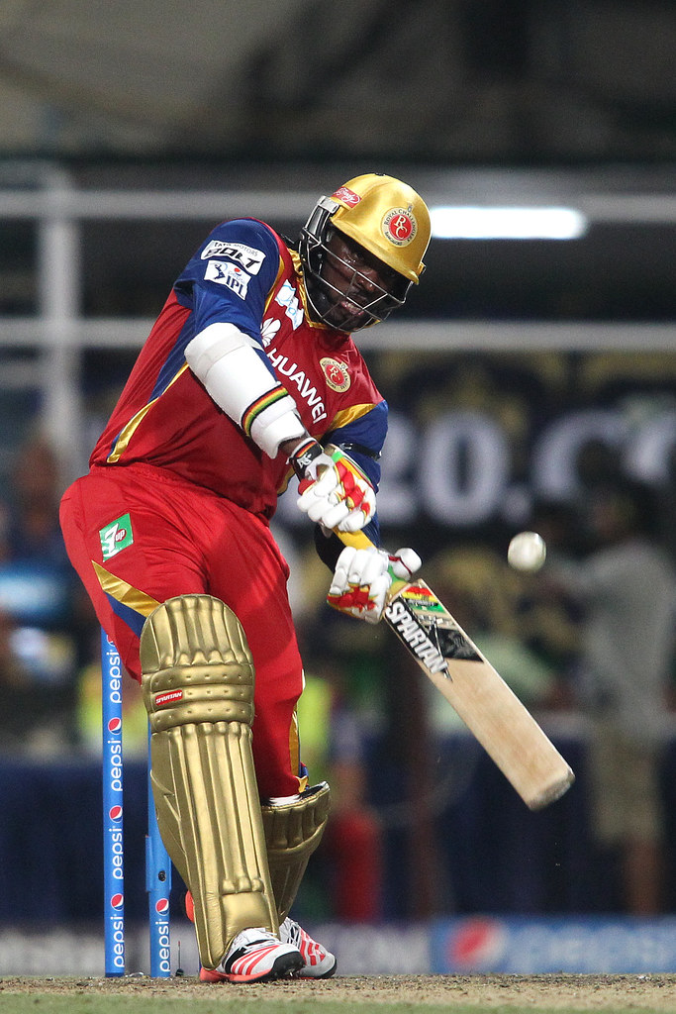
Indian Premier League
Analysis using tableau
This Photo by Unknown Author is licensed under CC BY-SA-NC

Slide 2
Background
The Indian Premier League, or IPL, is a T20 cricket league, which was founded in 2008 and is held every year. It sees participation from both national and international players, and eight teams representing eight Indian cities compete with each other in a double round-robin format in the league stages, which are followed by playoffs. Over the years, IPL has become one of the most-watched and most attended live sporting events all over the world.
You work as a data analyst at IFP, a nationally recognized news agency, which is based out of New Delhi, and provides news reports and feeds to magazines, newspapers and TV broadcasters all over the country. The Sports Editor of the agency has approached you to build a Tableau dashboard of IPL statistics over the years since its inception in order to create an infographic for a newsletter that their team is working on. For this newsletter, in some cases, they will use the visual representations as you have created in Tableau directly for their infographic, and in a few other cases, they will use important statistics after trying out the different filters and customizations that you have provided for interactivity. Therefore, you are expected to build an interactive dashboard in Tableau for this purpose.
You need to use the following two data set files:
•matches.csv - It contains match-level information for each and every match held in IPL from 2008 to 2017.
•deliveries.csv - It contains ball-by-ball information for each of the matches.

Slide 3
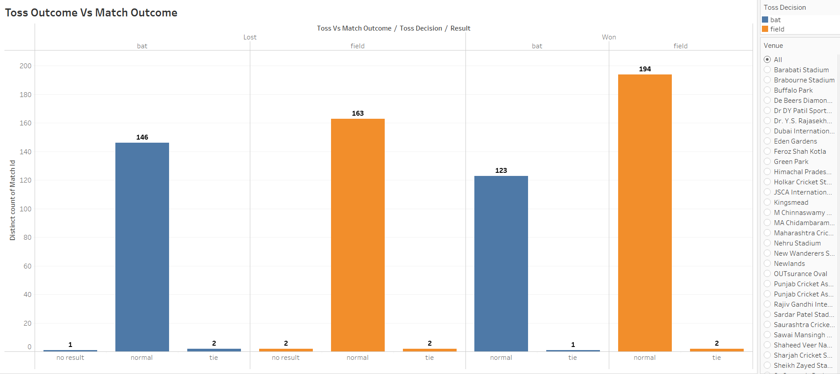
Toss vs Match outcome for each Ground/venue

Slide 4
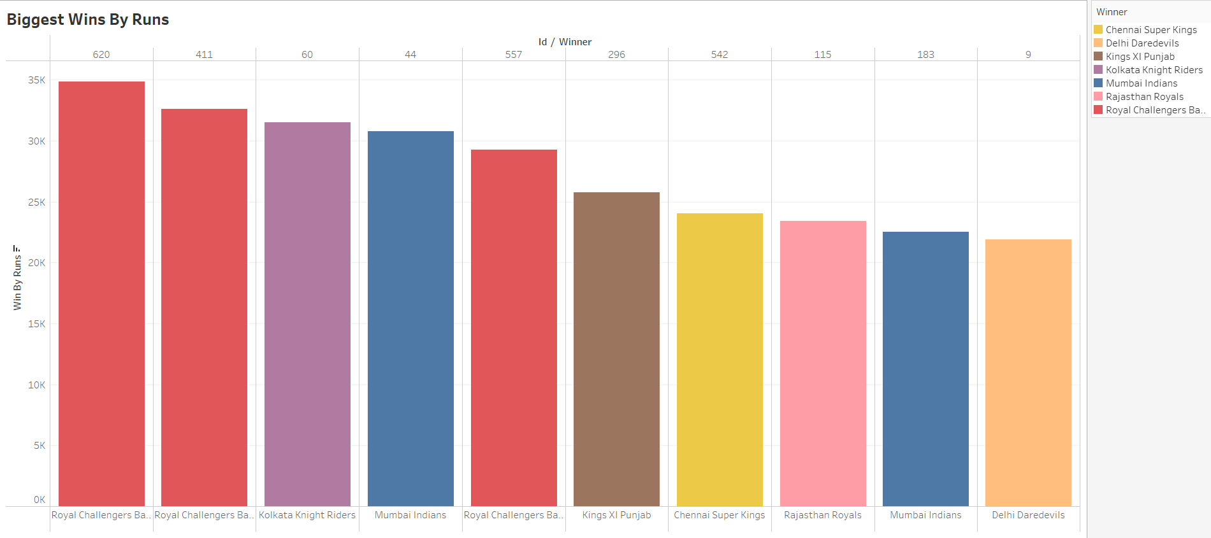
Biggest wins by Runs

Slide 5
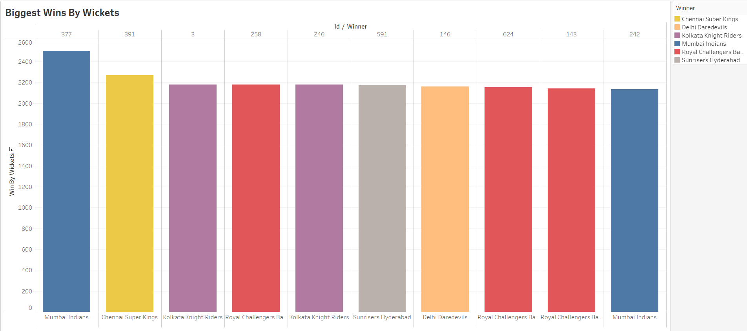
Biggest wins by wickets

Slide 6
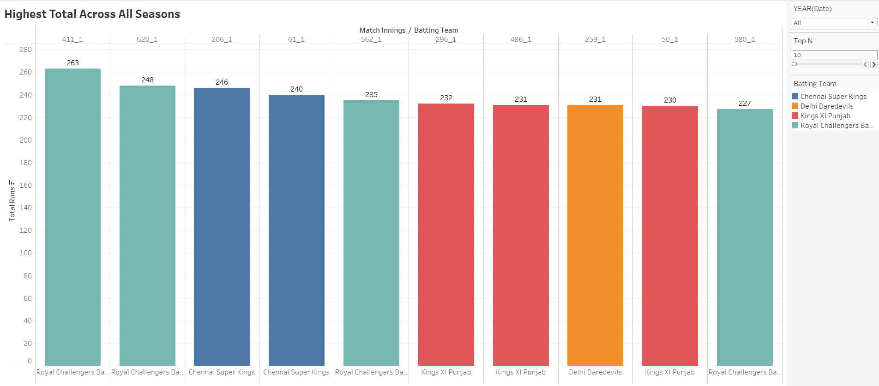
Highest total across all seasons

Slide 7
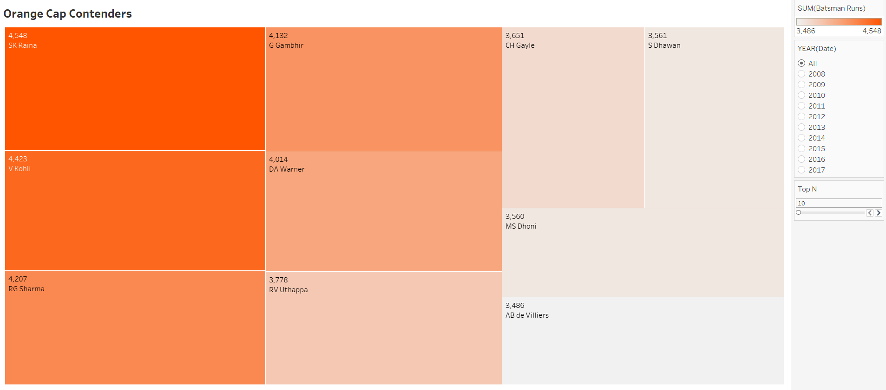
Orange cap contenders (The batsmen who have scored the maximum number of runs in a particular season)

Slide 8
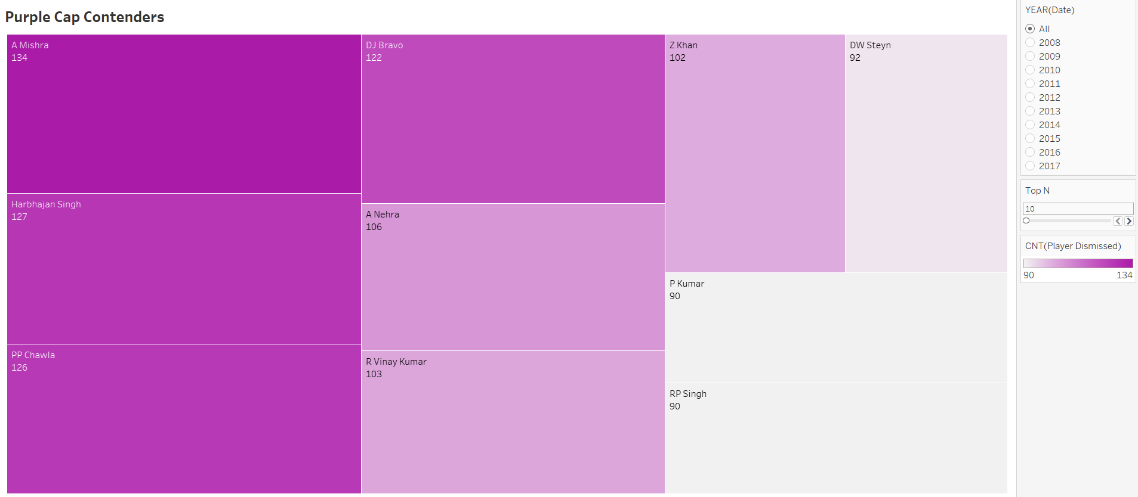
Purple cap contenders (The bowlers who have taken the maximum number of wickets in a particular season)

Slide 9
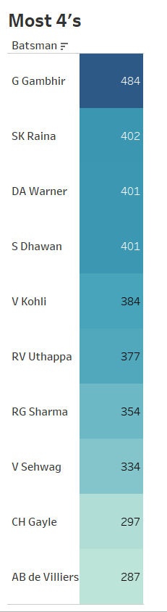
The batsmen who have hit the most number of fours

Slide 10
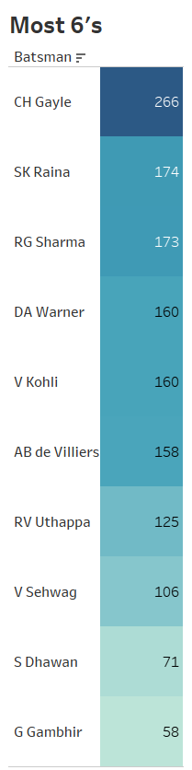
The batsmen who have hit the most number of sixes

Slide 11
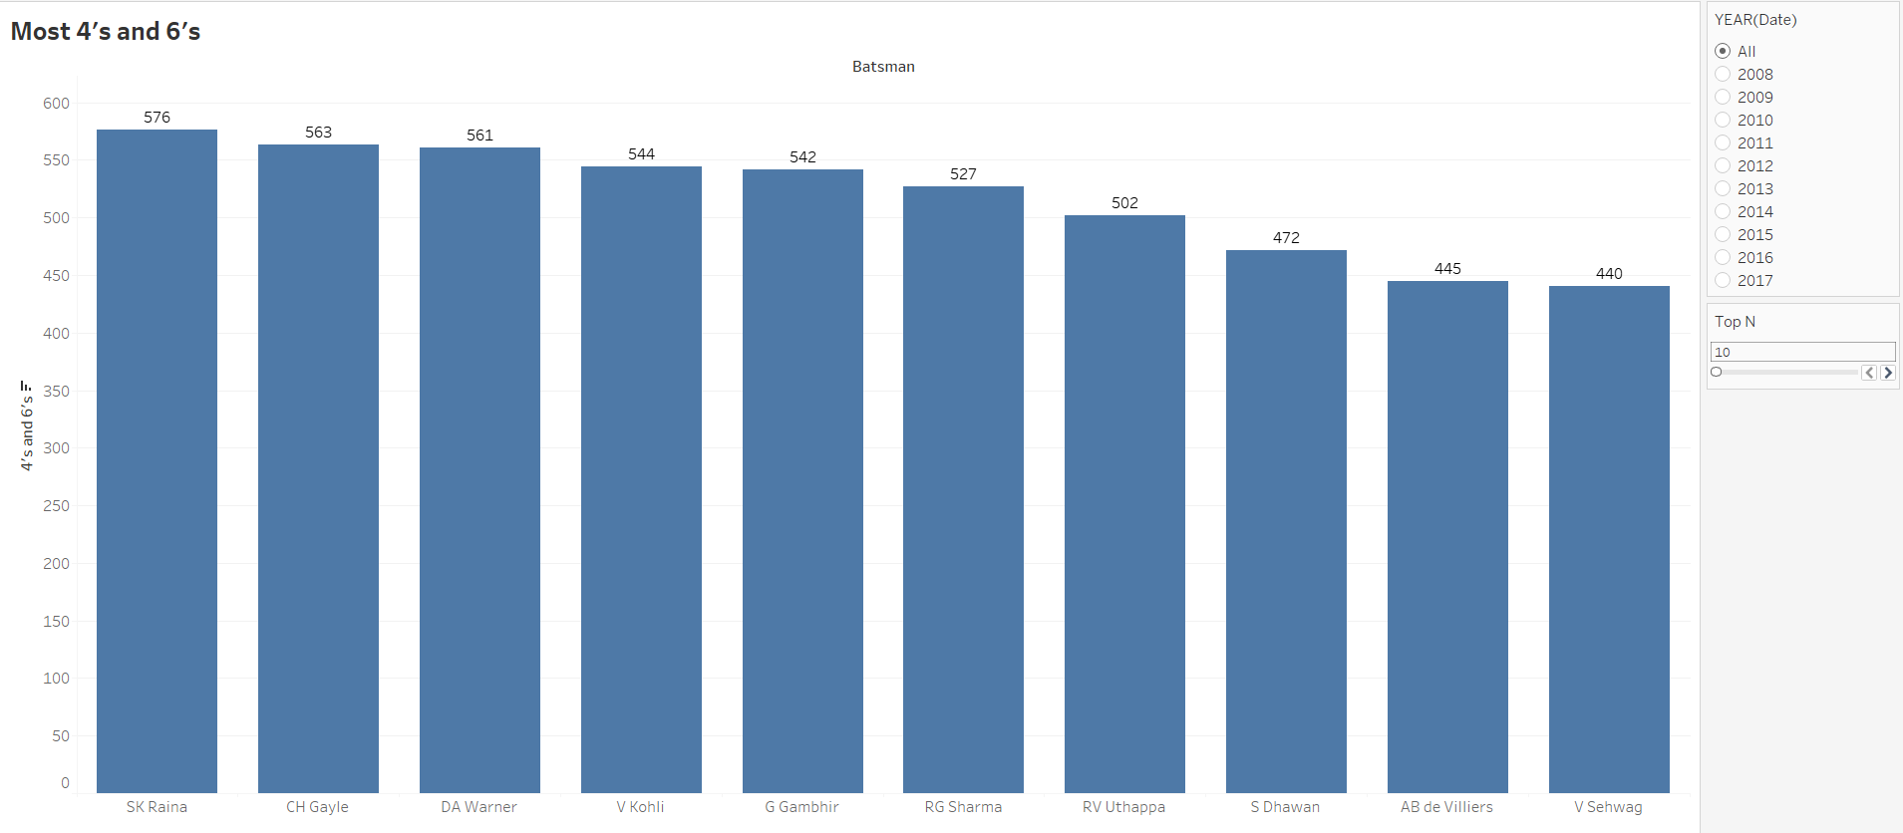
Batsmen who have hit the most number of fours and sixes ( per season and overall )

Slide 12
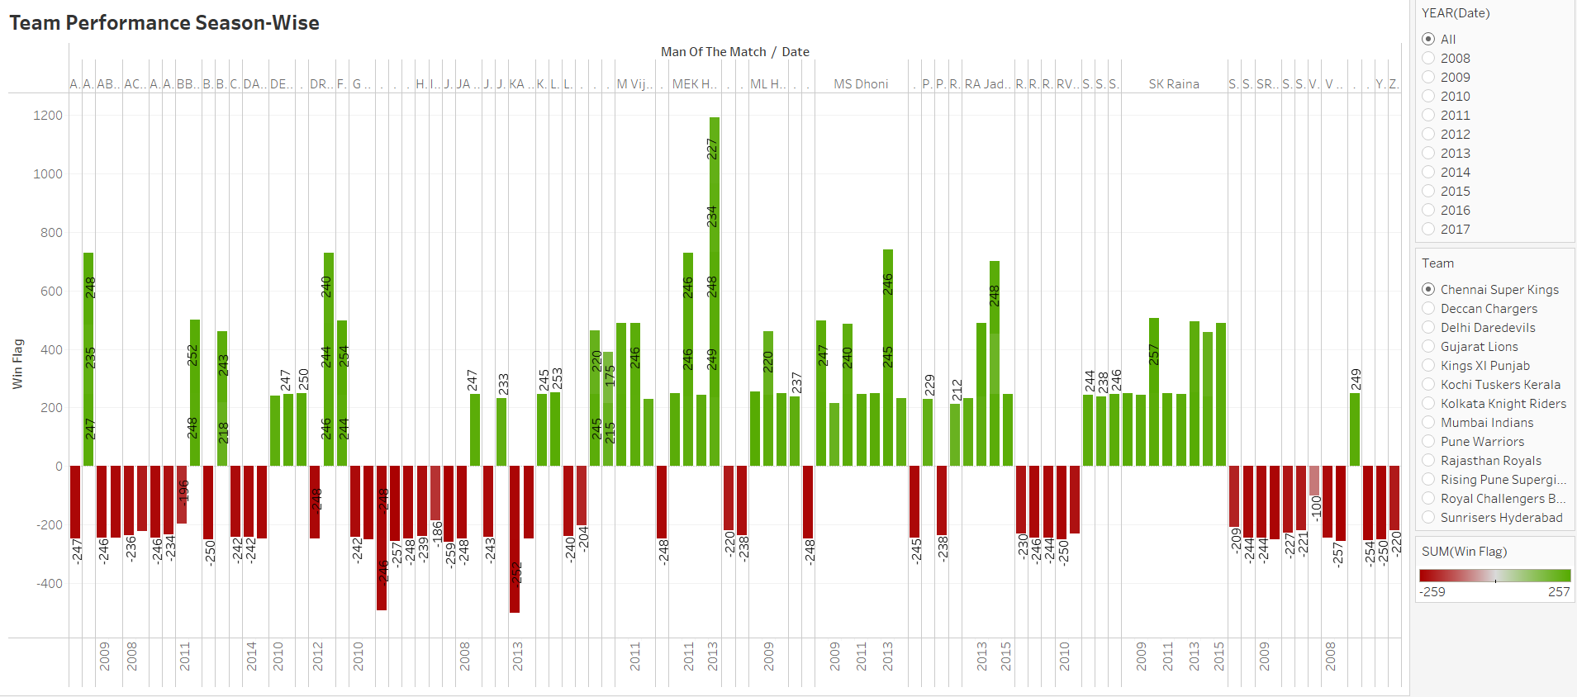
Team performance season-wise (wins vs losses)

Slide 13
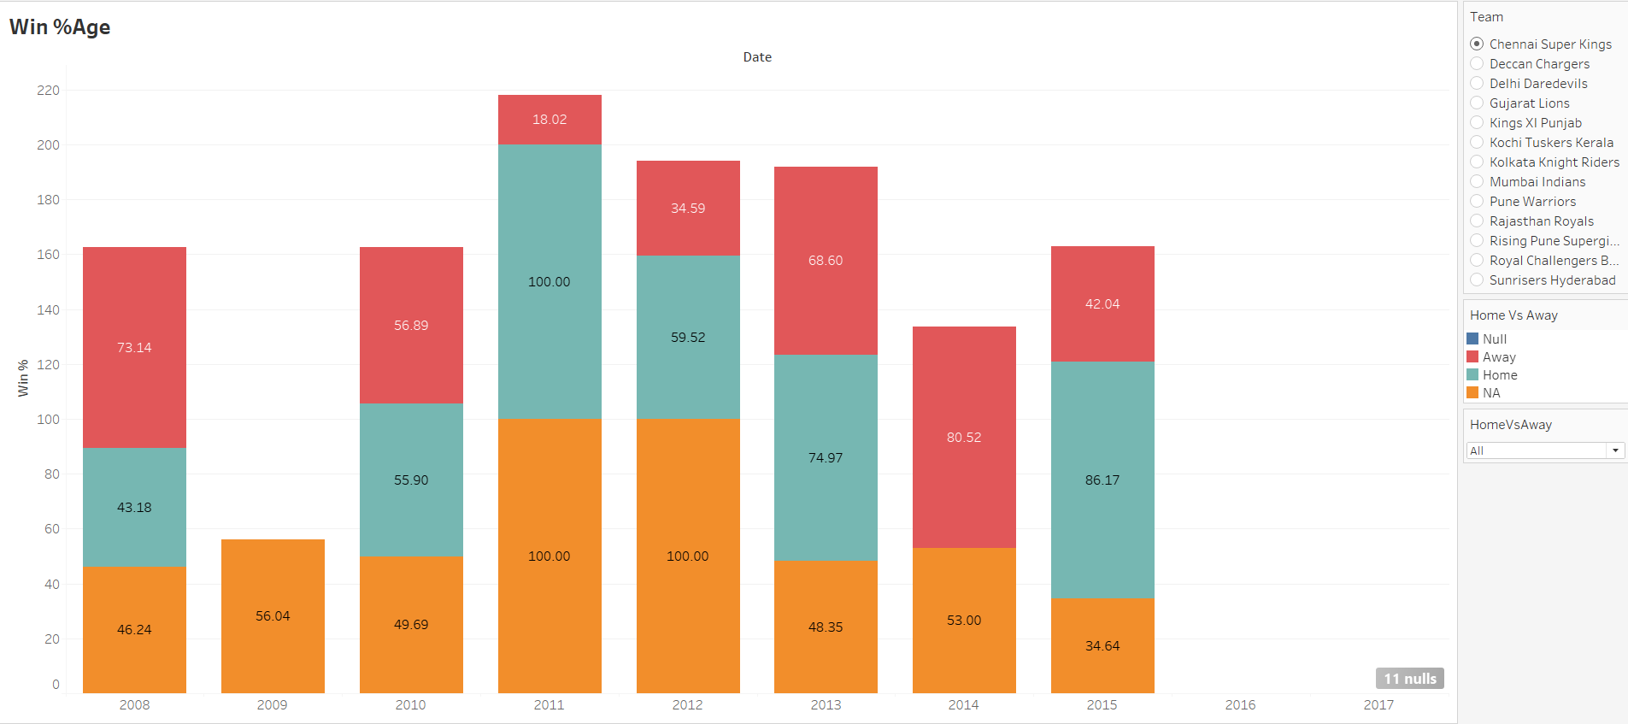
Win percentage (home vs away ground)

Slide 14
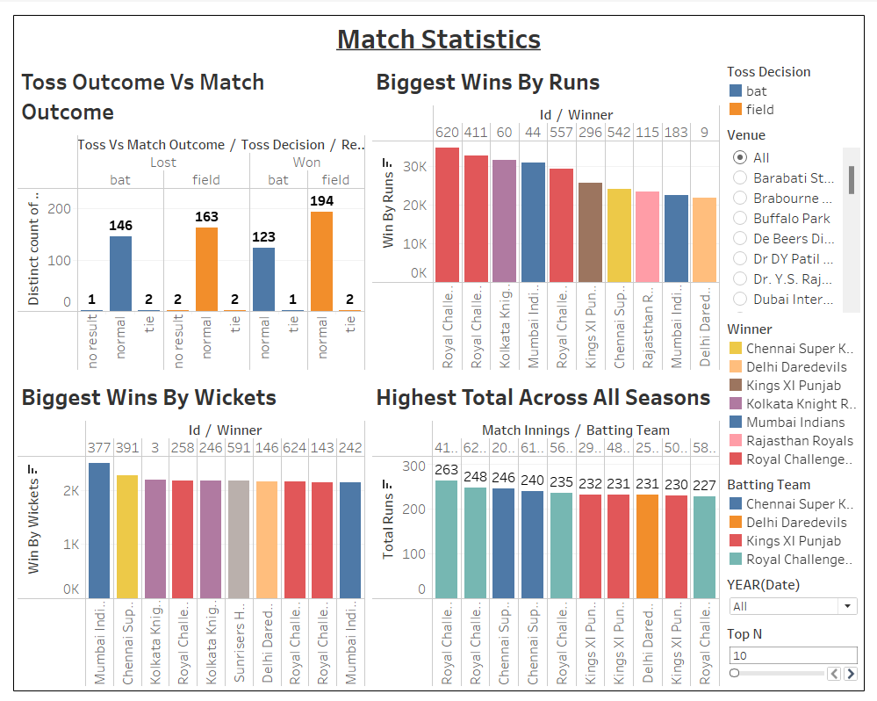

Slide 15
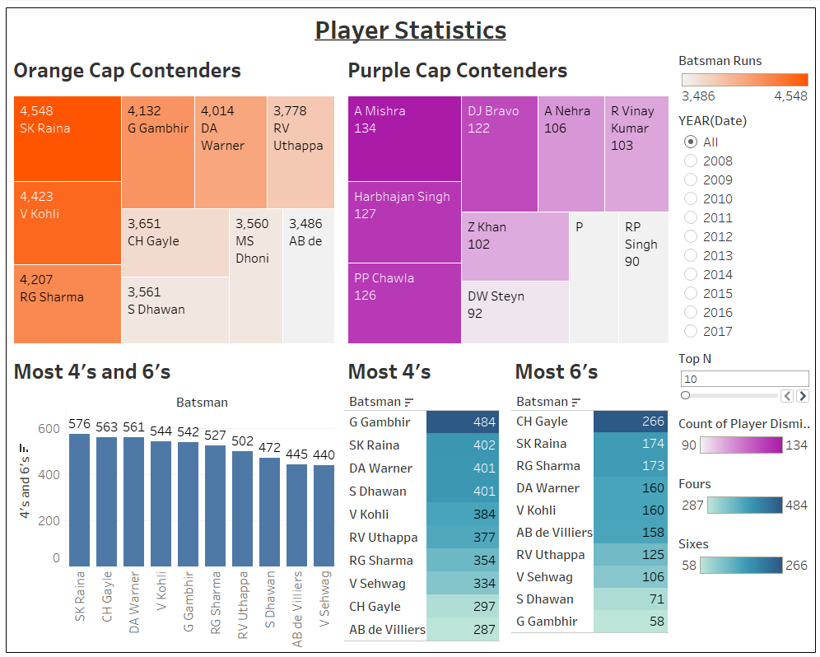

Slide 16
